Slide 1

PSA Proposal
Citizens’ Climate Lobby
By: Payton Thurston, Liberty Guilmette, Samuel Tomaszewski Lorenzo Martinez,

Slide 2

Introduction
What is CCL?
Citizens’ Climate Lobby (CCL) is a nonprofit, nonpartisan climate change organization that advocates for national policies to combat the ongoing climate crisis. CCL works to approach climate education by building upon shared values and encouraging supporters and volunteers to get involved in their local communities.
Why climate change?
Over the years, it has become more apparent that actions must be taken to combat climate change and its progression.
Climate change affects a variety of different earthly constituents, including: changes in weather patterns and temperatures, an increase in natural disasters, ecosystem changes and collapse, rising sea levels, economic strain, and even impact human health.
Recognizing these impacts helps bring emphasis to the importance of quick and unanimous action for policy changes and community efforts.

Slide 3
Research Purpose
Develop an understanding of young adults’ involvement with climate change to influence pro-environmental advertising. This will allow us to create a pro-environmental public service announcement (PSA) for CCL that effectively targets the young adult audience by using key research findings to guide our approach.

Slide 4

Research Design: Survey
PARTICIPANT DEMOGRAPHICS
Total: 61 participants
Ages
15 – 18: 11.5%
19 – 22: 60.7%
23 – 26: 21.3%
27 – 30: 4.9%
31+: 1.6%
Class Standing
Freshman: 16.9%
Sophomore: 10.2%
Junior: 16.9%
Senior: 33.9%
Not in College: 22%
Collection
Google Forms survey
Data collected between Nov. 23 and Nov. 27
All participants read and accepted the provided informed consent

Slide 5

Research Results: Survey
90.2% of people believe there has been a change in weather in the past 5 years, and 91.7% of people believe that the change in weather is due to climate change
41 people said environmental data has the highest consumer impact in pro-environmental advertising
39 people said impact stories from real people have the highest consumer impact in pro-environmental advertising
58 out of 61 people said there should be policy change regarding climate change
16 people ranked water insecurity and mental health with the highest future impact occurring from climate change
83.3% of people believe the economy is affected by climate change
Future generation impact
No impact: 0%
Small impact: 6.6%
Moderate impact: 21.3%
High impact: 29.5%
extreme impact: 42.6%
46 people think agriculture is one of the areas of the economy most affected by climate change, the second highest section was the energy sector with 28 votes

Slide 6

Research Design: Focus Group
PARTICIPANT DEMOGRAPHICS
Date & Time: Tuesday, Nov. 12 @ 5 p.m.
Participant A: 21-year-old female; Communication Sciences and Disorders
Participant B: 19-year-old female; Environmental Studies
Participant C: 19-year-old female; Computer Science
Participant D: 20-year-old male; Sports Management
Location: University Park Library; Group Study Room
The focus group consisted of four participants, a moderator, a recorder, and an observer. The recording of the focus group was conducted by concurrent audio recording and a typed recording of each topic/question discussed.
All participants agreed to participate in the focus group and signed an informed consent sheet

Slide 7
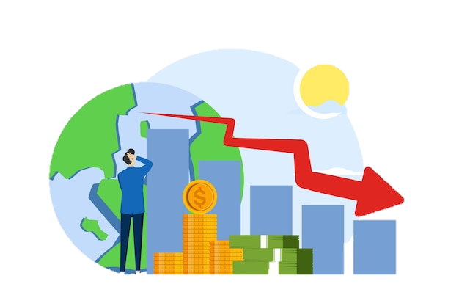
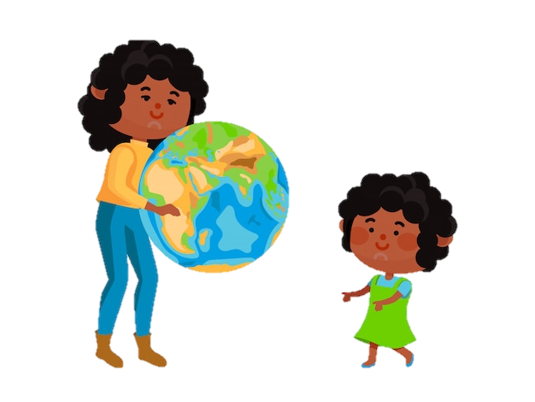
Research Results: Focus Group
Identified Themes
Concern for future generations due to the impact of climate change
Collective fear of climate change influencing wildlife extinction rates
The economic impact due to climate change and the Domino Effect

Slide 8
Research Results: Key Findings
Policy change regarding climate change is necessary
Concern for future generations
Economic impact

Slide 9
PSA Proposal
ANIMATION IDEAS
PROPOSAL
A calendar flipping through the months with a checkmark on each day to signify no days off during the school year (no snow days).
Multiple polar bears in the snow and they disappear one by one until there are none left.
A kid opens a fridge to find limited food options inside.
“Your actions shape their world.”
Without your help, future generations won't have snow days, polar bears, or reliable food sources. Join Citizen's Climate Lobby in the fight for policy change to give them the future they deserve.
RATIONALE
Comparing data from our research methods, we can identify that people are actively concerned about the impact climate change will have on future generations. This includes aspects of personal family impact, economic impact, and weather detriment.

